Slide 1
SHWN_TFCH (TRAFFIC TECH INC)
Always key the following, visible in the invoice separator sheet:
Batch ID (68a) BAT ID (69) Value/No
Client Code (68b) CL CODE (69) SHWN Scac Code (68c) SCAC CODE (69) TFCH

Slide 2
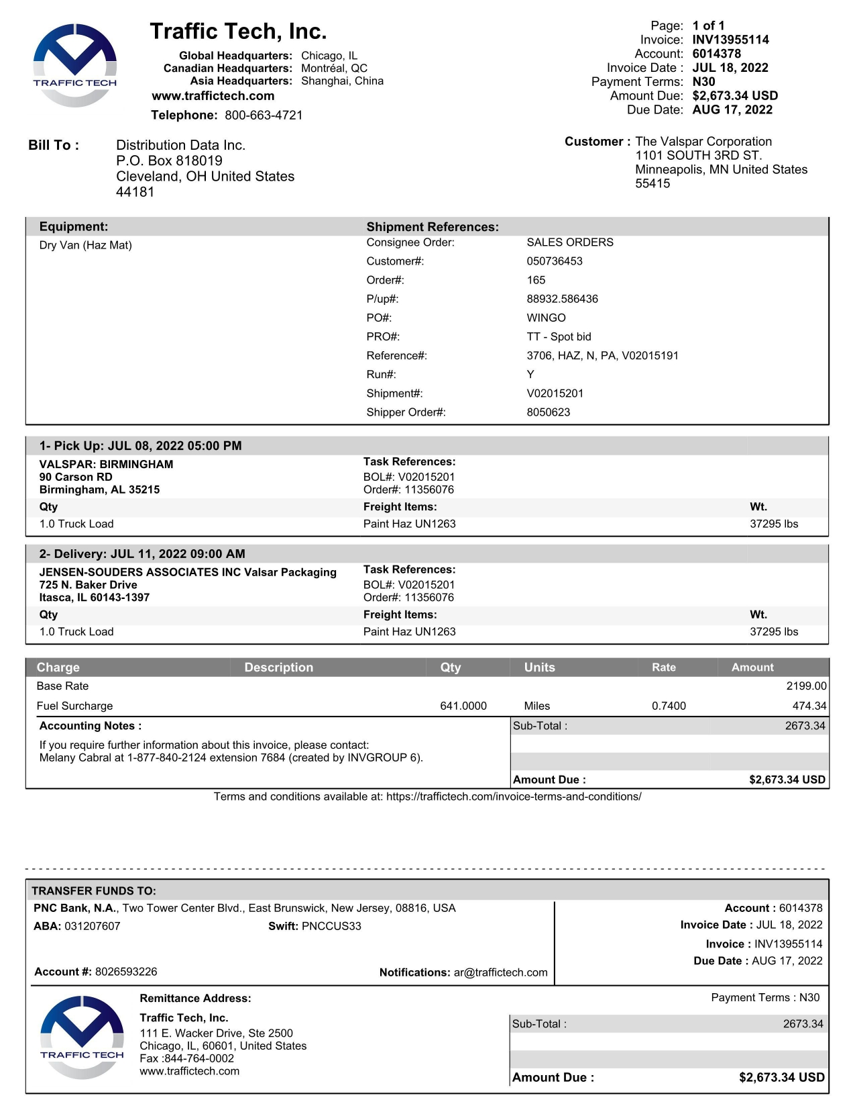
05
03
10
02 BILL TO
05 ACCT
03 INV KEY
10 DATE
11 DUE
68a REF
68b ORD NO
68c PO NO
68d PRO NO
68e SHIPMENT ID
68f EQUIPMENT TYPE
68g BOL
61 PICK UP
61 DELIVERED
27 SHIPPER INV
30 CONSIGNEE INV
46 PIECES
90 PROD DESC
42 ACTUAL WT
43 FNCL WT
44 ACTUAL WT UOM
45 FNCL WT UOM
71 LINE ITEM DESC
74 LINE ITEM QTY Q
48 DISTANCE
49 DISTANCE UOM
75 LINE ITEM RATE
85 LINE ITEM AMT
08 INV AMT
09 CURR
14 FB AMT
01 REMIT TO
38 SRVC LEVEL
02
11
68f
68a
68b
68c
68d
68a
68e
61
68b
27
68g
46
38
68b
42/43
44/45
62
90
30
72
74/48
49
75
85
08/14
09
01

Slide 3
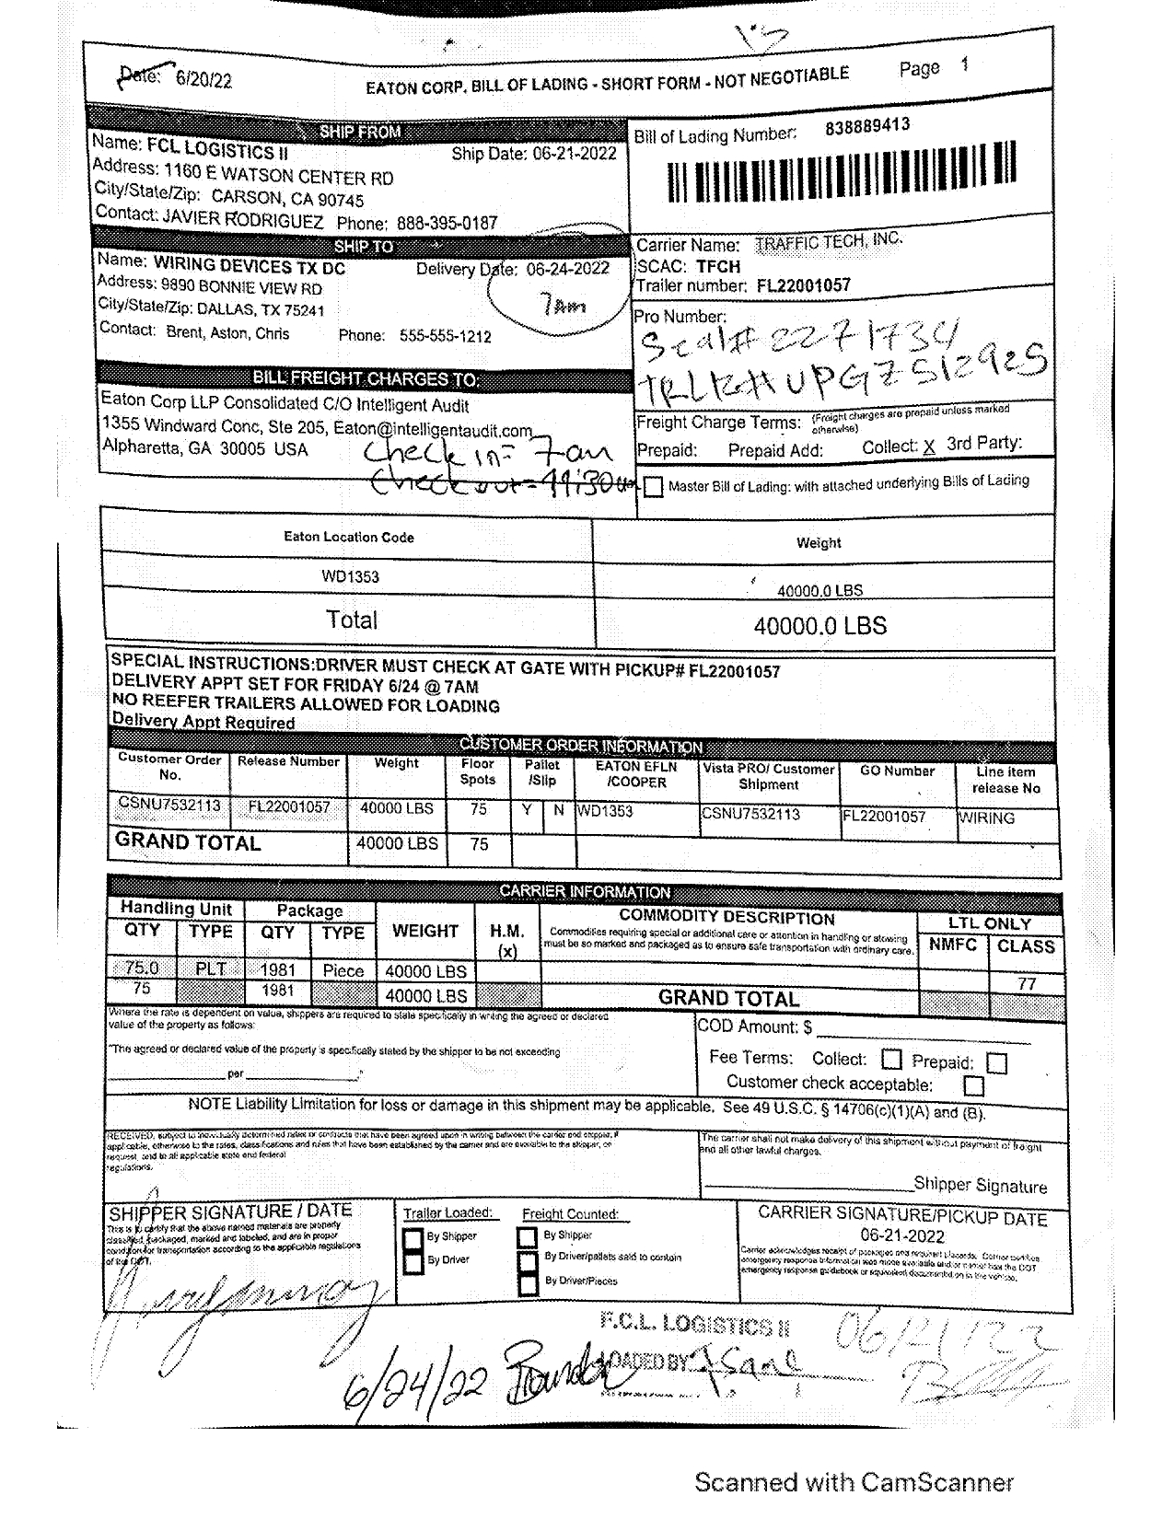
28
68a
68a BOL
68b ORD NO
28 SHIPPER BOL
31 CONSIGNEE BOL
36 FRGHT TERM
95 PCS CNT
96 GROSS WT
97 NET WT
98 WT UOM
31
36
68b
95
96/97
98

Slide 4
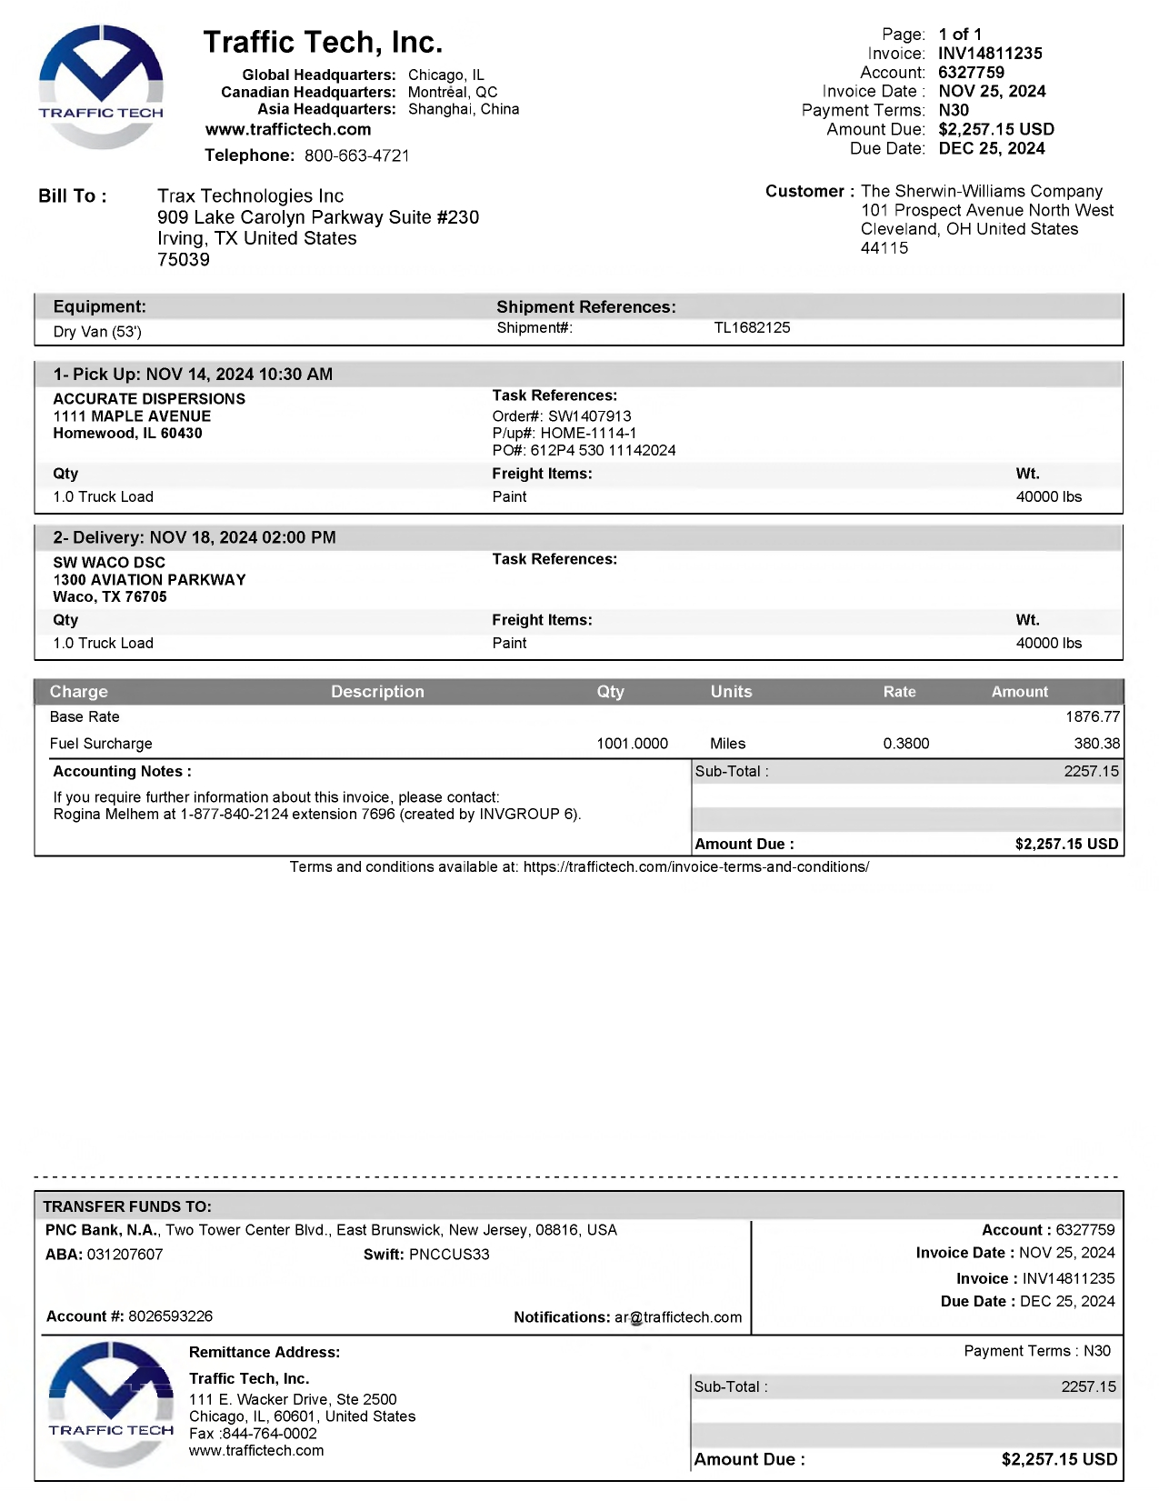
02
02 BILL TO

Slide 5
6
For Verification Table
 | NAME | DATE
DI-60359 | REGINE S. DERIADA | 6/11/2024
DI-66223 – update according to instructions (slide 4) | KHEILA MARY A. INOC | 11/26/2024

